Slide 1

Improving Length of Stay Prediction
Using a Hidden Markov Model
S04
Machine Learning in Clinical Predictive Modeling I
Presenter : Mani Sotoodeh
Institution : Department of Computer Science - Emory University
Twitter: @Manis29467226
#IS19

Slide 2

Importance of Length of Stay Prediction
Physician correctly predict short or long staying patients only 50% of time
Intervention to prevent adverse outcomes in patients
Optimization of resource allocation (Equipment and Beds)
Allocation of staff and care to high risk patients
Improving overall patients' satisfaction and hospitals’ reputation
Class | < 48 Houres | 2-5 days | > 5 days
Accuracy | 53.1 % | 59.8 % | 31.1 %
Adapted with changes from : Nassar Jr AP, Caruso P. ICU physicians are unable to accurately predict length of stay at admission: a prospective study. International Journal for Quality in Health Care. 2015;28(1):99–103.

Slide 3

Motivation, The case for HMM
Most of the previous work is on classification rather than regression
More accurate prediction, increasing precision where its needed the most
Track multiple physiologic measurements and their interactions over time
Evolution of Latent variables through time may capture the aggregate trend
States can be interpretable by physicians
Possibly indicating severity or progress of patients’ underlying disease symptoms

Slide 4
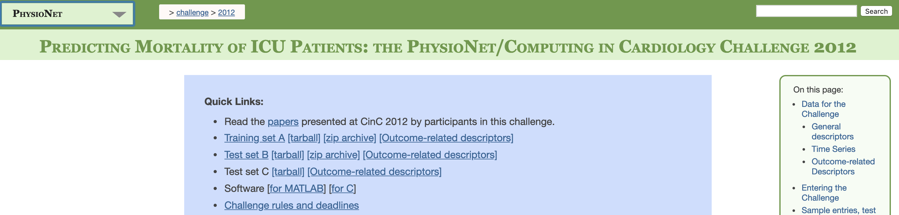
Dataset : Physionet2012
Physionet 2012 Challenge
General demographics including age and gender + 37 different physiological measurements of 4000 patients for the first 48 hours after their ICU admission
Publicly available without any paperwork and thus easily reproducible by others
More studies available for comparison
The size of dataset while sufficient for learning is also realistic for practical purpose, i.e. a single hospital
https://physionet.org/challenge/2012/

Slide 5
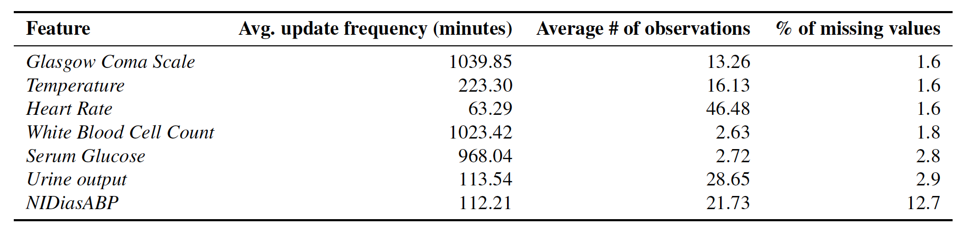
Problem Statement
Regression task
Input : Physiological Measurements throughout time for 48 hours
Blood pressure
Temperature
Heart rate
Glasgow Coma Score
Serum Glucose,
White Blood Cell Count
Urine Output.
Output : Length of stay in ICU in days

Slide 6
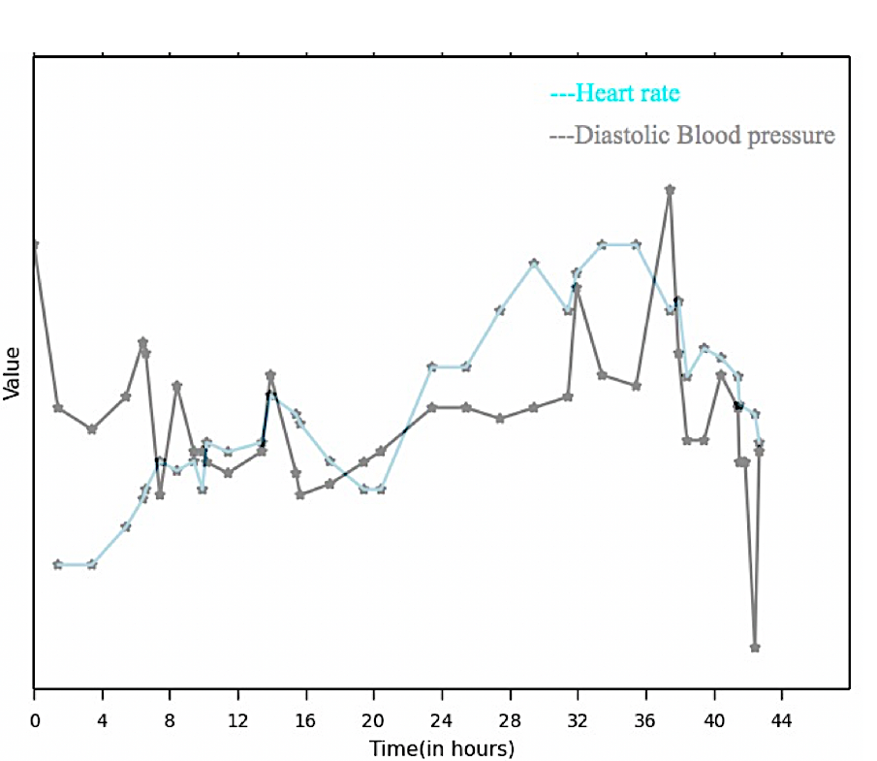
Baseline Models
Minimum, Maximum, Average, First and Last in time (5 statistics) for each of the 7 variables
35 features in total for each patient
Five common regression models: LASSO regression
Ridge regression
Poisson regression
Binomial regression
Support vector regression (SVR)
Annotated example for a given patient and two physiological measurement
BP maximum
BP First
HR maximum
HR Average
HR Last
BP Last
BP Average
HR minimum
HR First
BP minimum
Meanwhile HMM Model attempts to utilize all temporal information by considering all values

Slide 7
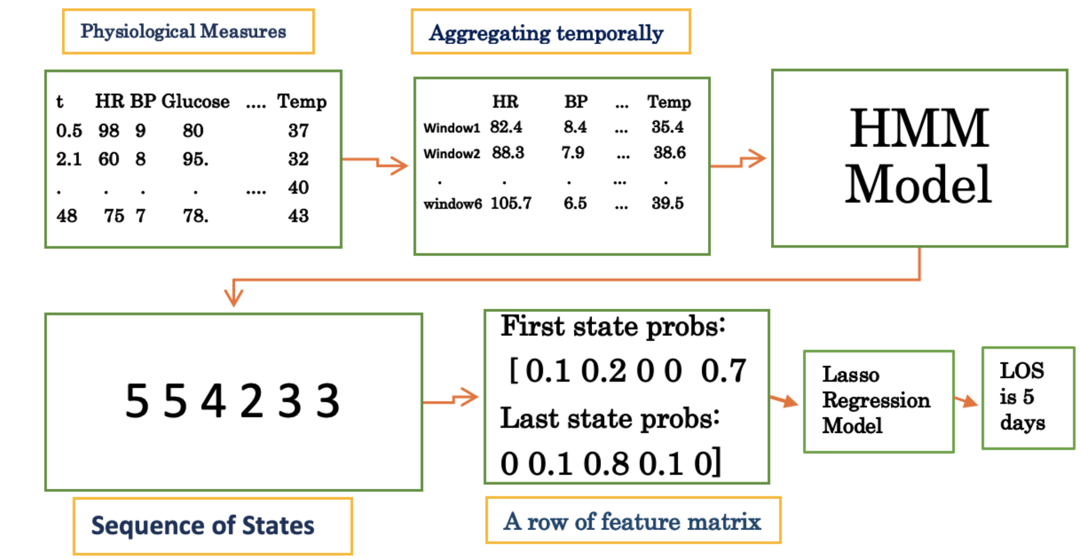
HMM Model Big Picture
Physionet 2012 data after imputation
Average, median or last time point value
Observations for a multi-feature Gaussian model
Spits out likelihood of each state for a given time window
Most likely sequence of states
Len(Sequence) = # time windows

Slide 8
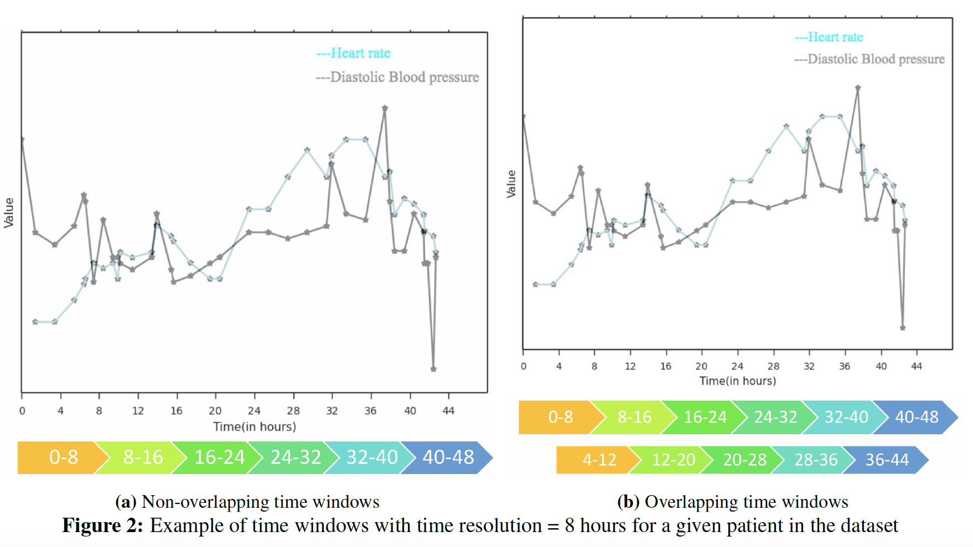
Visualization of Data for a single patient

Slide 9
Design choices
Number of states
Overlapping or non-overlapping time windows
Time Resolution
Stability of results

Slide 10
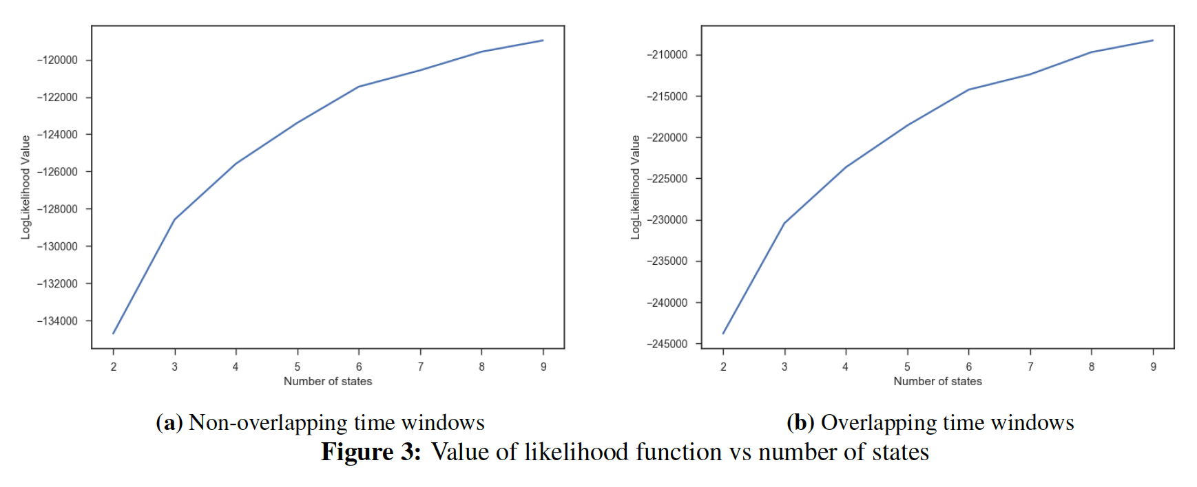
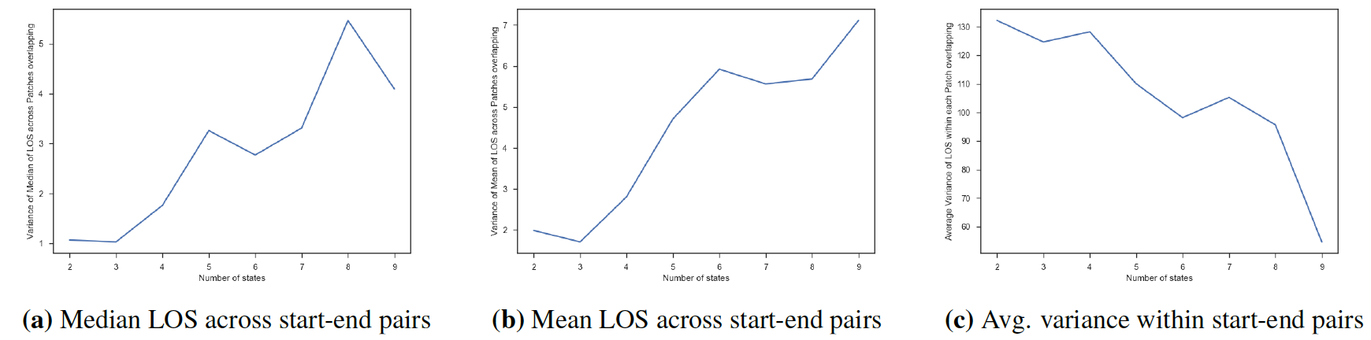
Optimum # of states

Slide 11
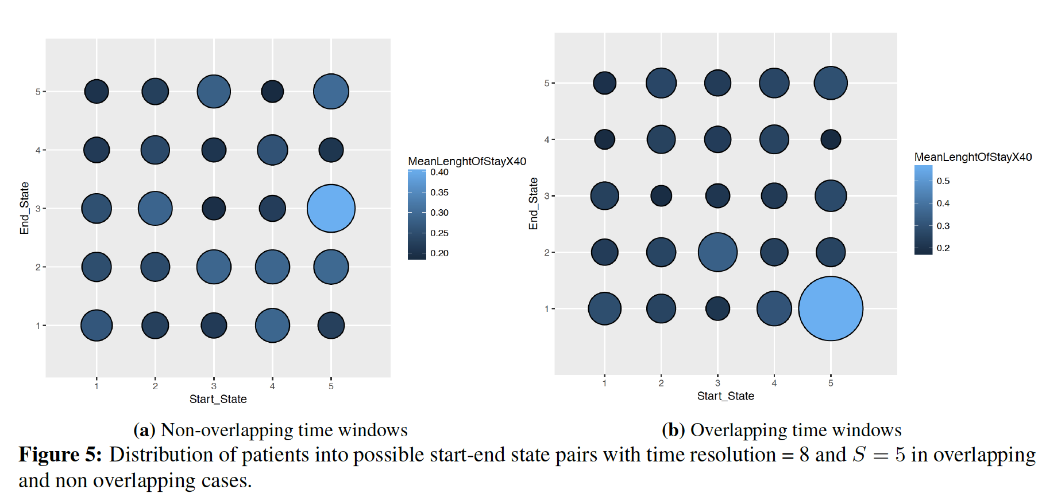
Non/Overlapping time windows

Slide 12
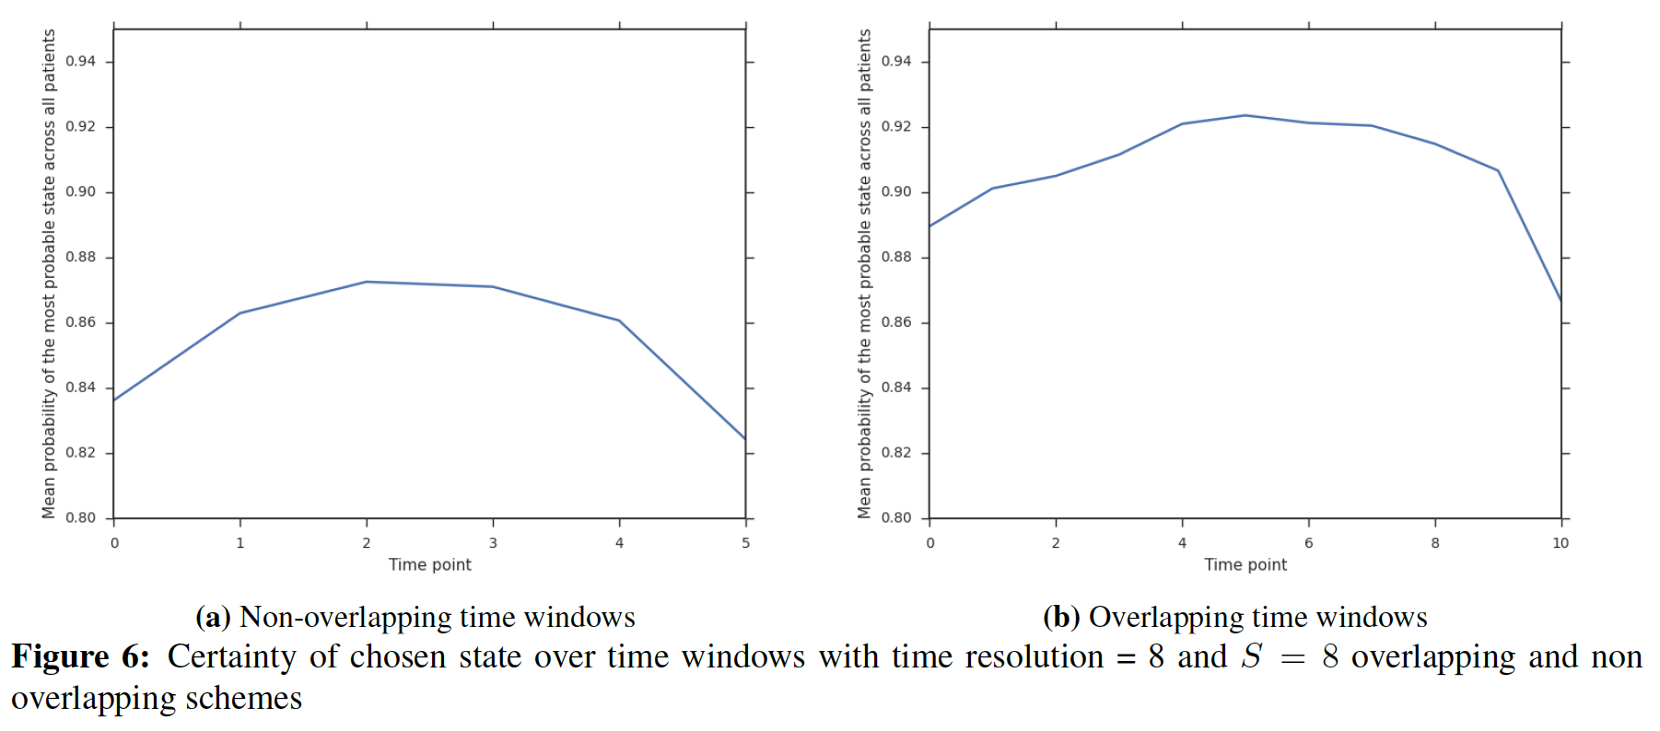
Overlapping edge - continued

Slide 13
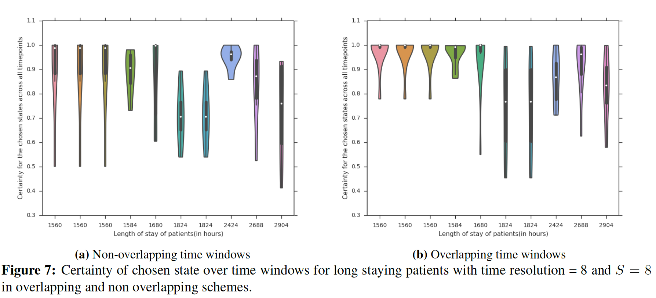
Overlapping edge-continued

Slide 14
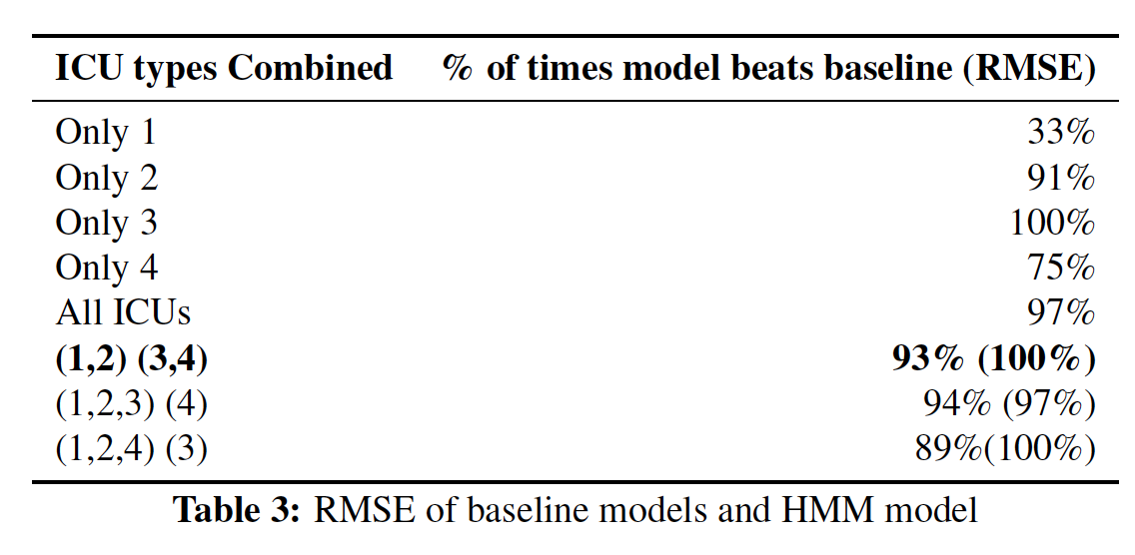
Combining ICU type

Slide 15
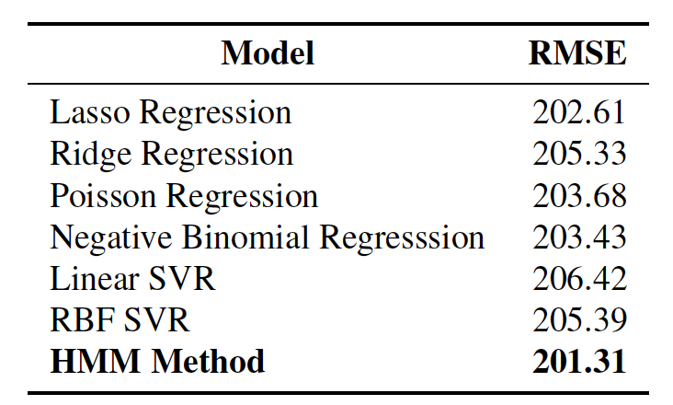
RMSE Comparison

Slide 16
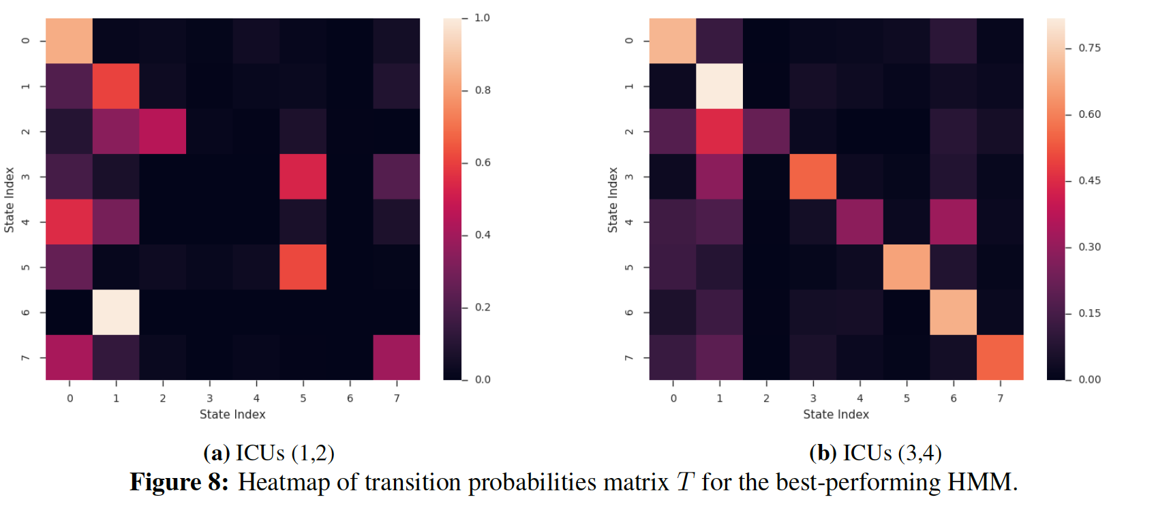
Interpretability

Slide 17
Thank you!
Email me at: msotood@emory.edu

